Slide 1

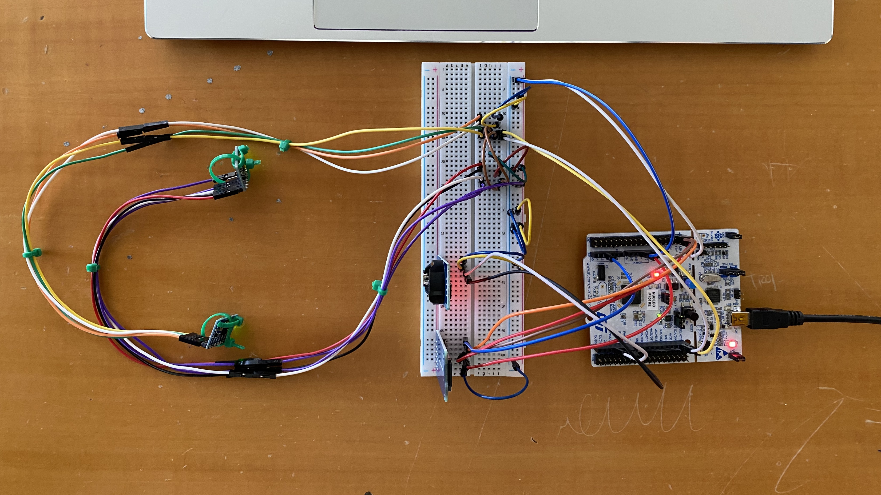
Air mouse - Fingers
Embedded Systems 2021/2022
Computer Engineering - University of Salerno
Group members:
Ranieri Speranza 0622701687 s.ranieri4@studenti.unisa.it
Mancusi Ernesto 0622701668 e.mancusi2@studenti.unisa.it
Parrella Giuseppe 0622701665 g.parrella9@studenti.unisa.it
Sonnessa Francesco 0622701672 f.sonnessa@studenti.unisa.it

Slide 2
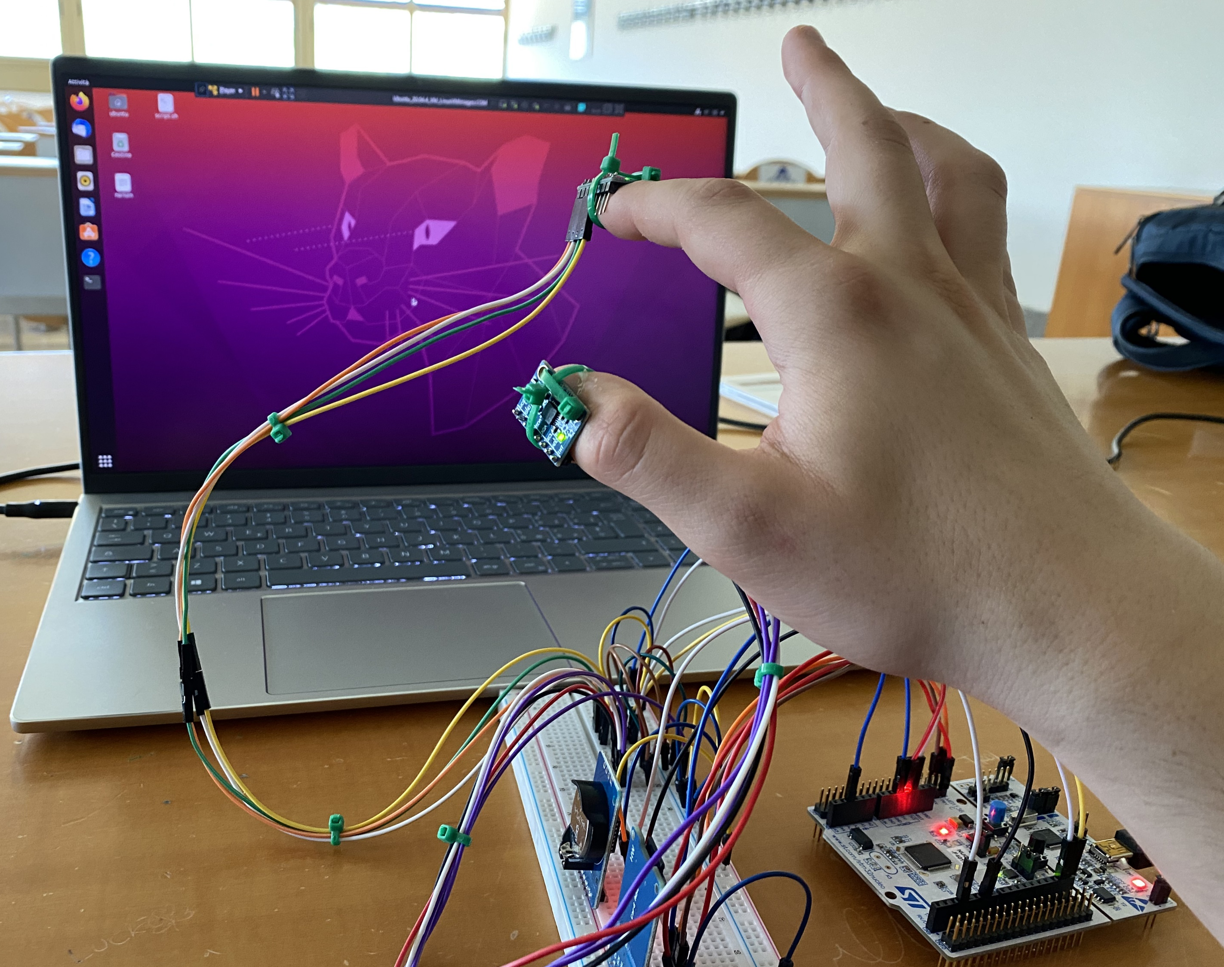
Project’s Aim
The project aims to realise a wearable mouse.
Using the accelerometers placed on the fingers, it is possible to interpret hand gestures in the following commands:
Left Click
Double Left Click
Zoom In / Out (+/-)
Alt + Tab (with windows switch and release)
Furthermore, all commands performed with the mouse are recorded in a text file saved on a Micro SD card.

Slide 3
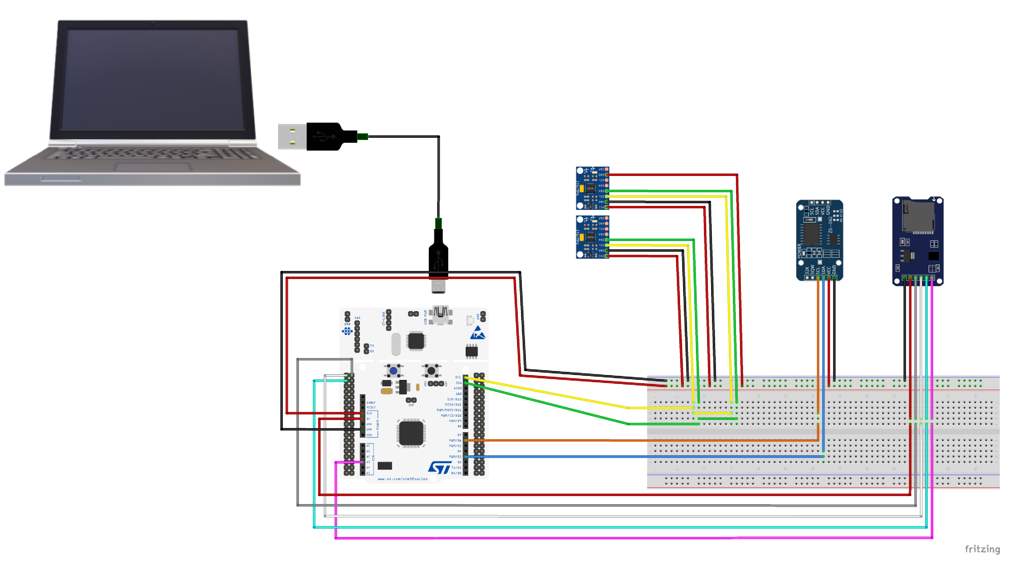
Hardware Schema Connections

Slide 4




Software Architecture
I2C
Reading Task
I2C
Log Task
SPI
Command Task
STM32F401
USART
Command Executor
PC

Slide 5
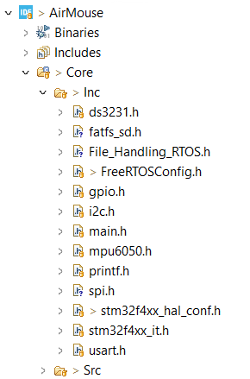
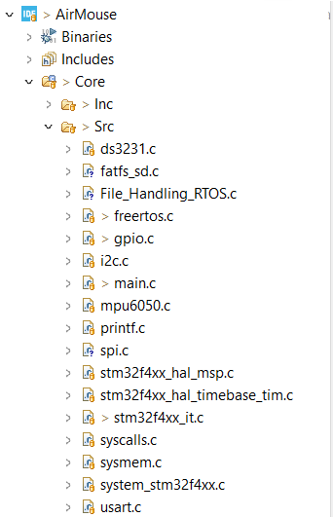







Software Architecture
DS3231
RTC Module Driver
Micro SD Reader Driver
FreeRTOS
MPU6050
Accelerometer/Gyroscope Driver
Header files
Source files

Slide 6
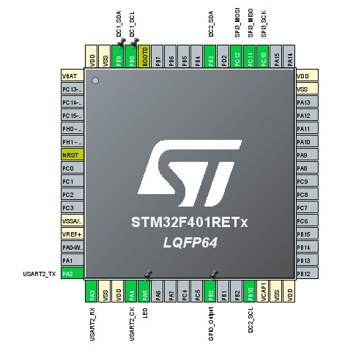
Protocols and Interfaces
I2C1
I²C port used for the accelerometers.
Addresses: 0x69 on thumb, 0x68 on index.
I2C2
I²C port used for the Real Time Clock module.
SPI3
SPI port used for the Micro SD reader.
USART2
Serial port of the board used for communication with the computer.
On board LED
Visual indicator of the system status:
ON, for “System ready”
OFF, for “System not ready”

Slide 7
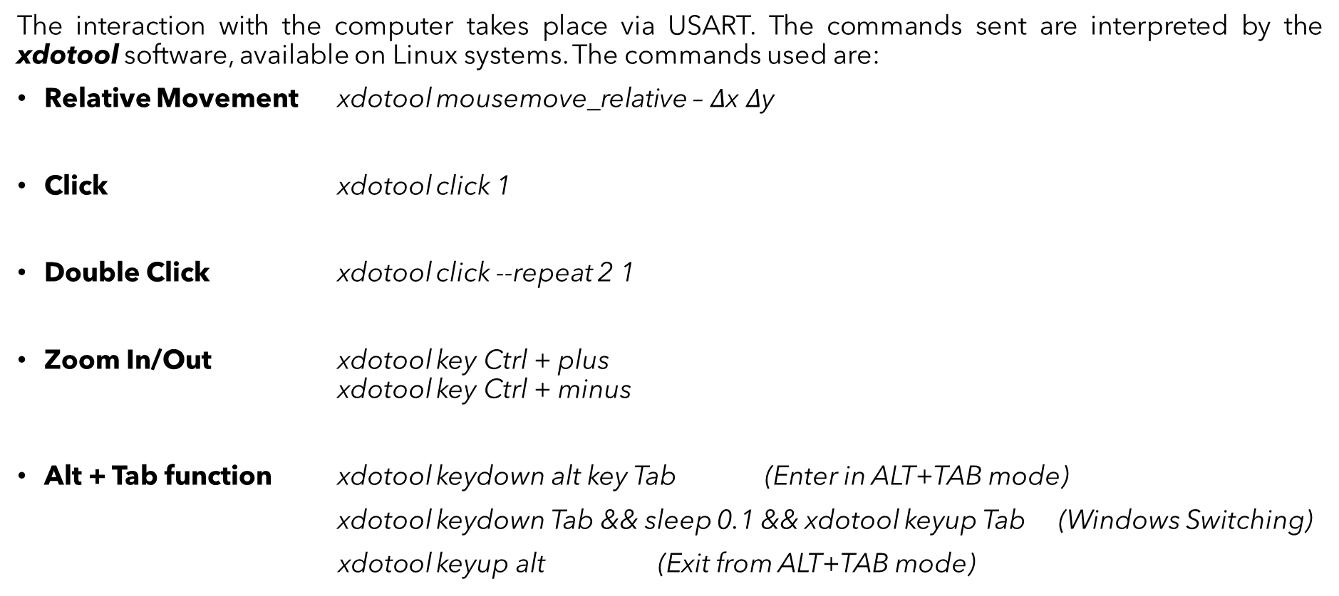
Protocols and Interfaces
The interaction with the computer takes place via USART. The commands sent are interpreted by the xdotool software, available on Linux systems. The commands used are:
Relative Movement xdotool mousemove_relative – $Δ$x $Δ$y
Click xdotool click 1
Double Click xdotool click --repeat 2 1
Zoom In/Out xdotool key Ctrl + plus xdotool key Ctrl + minus
Alt + Tab function xdotool keydown alt key Tab (Enter in ALT+TAB mode)
xdotool keydown Tab && sleep 0.1 && xdotool keyup Tab (Windows Switching)
xdotool keyup alt (Exit from ALT+TAB mode)

Slide 8
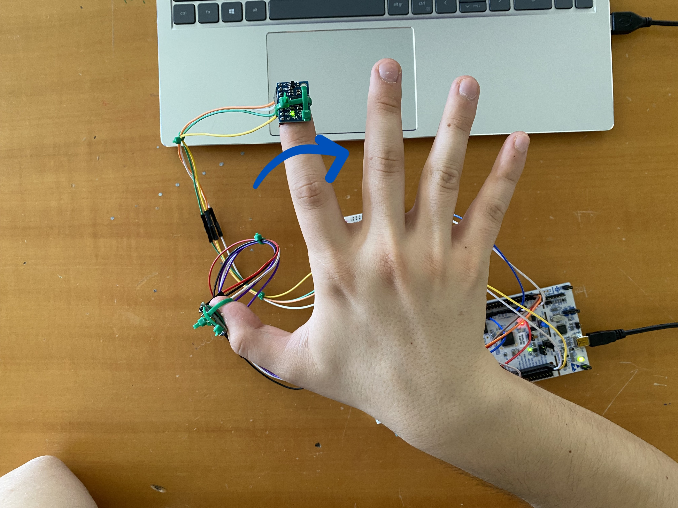
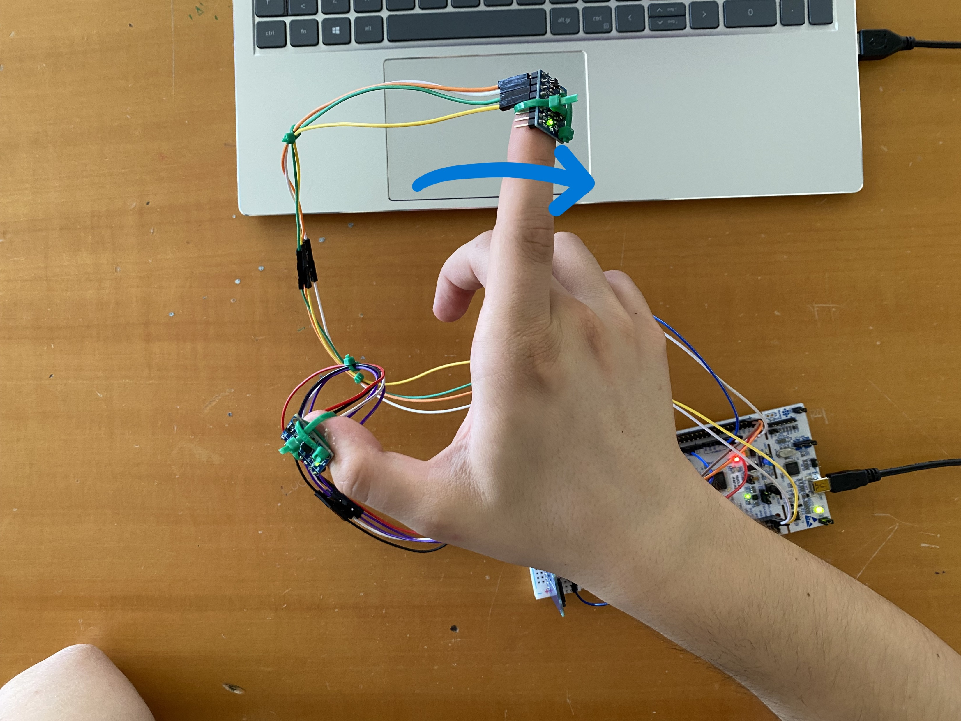
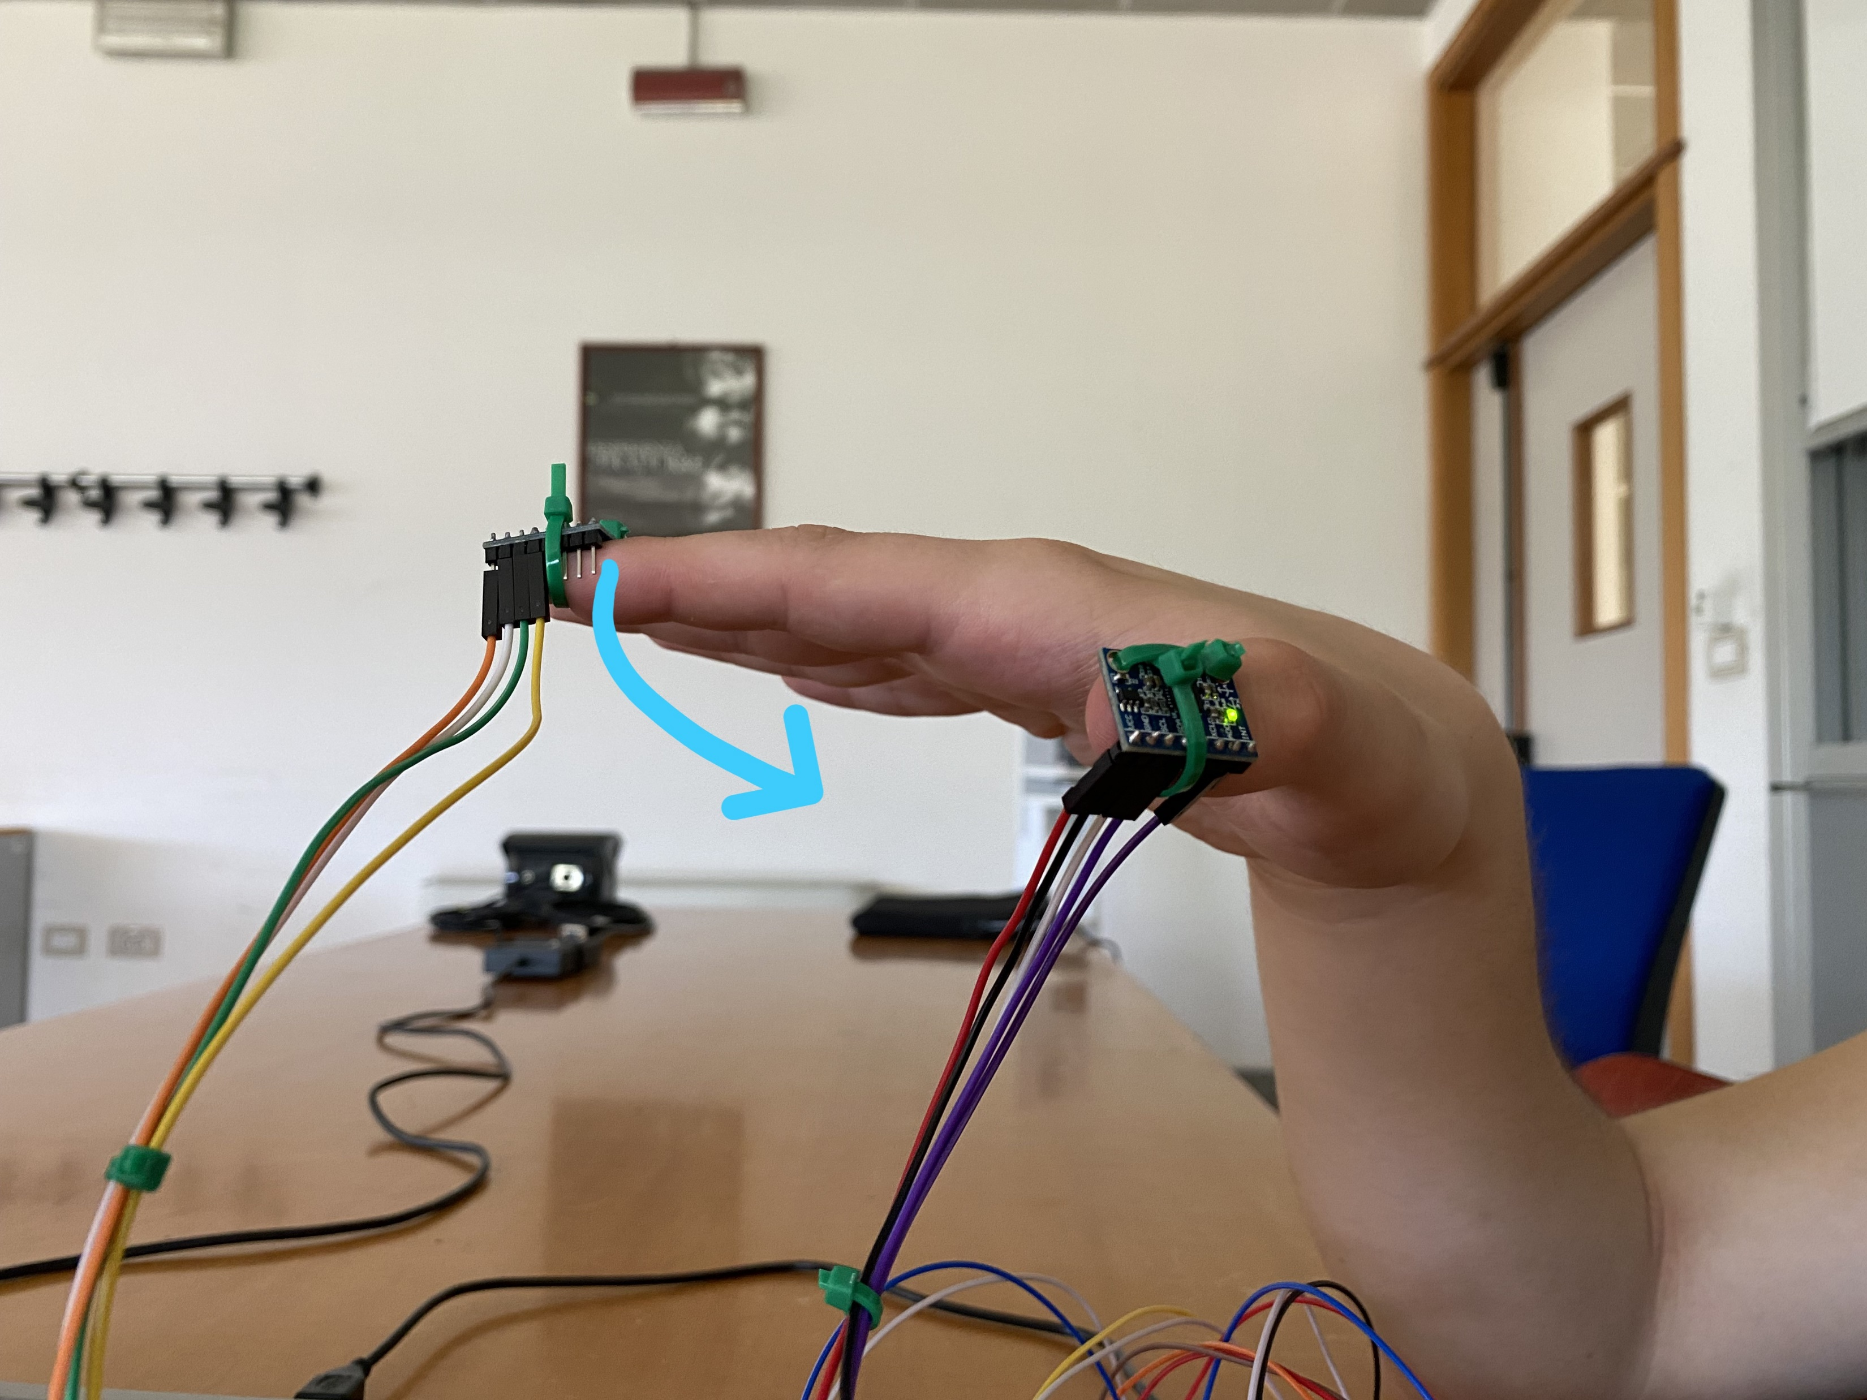
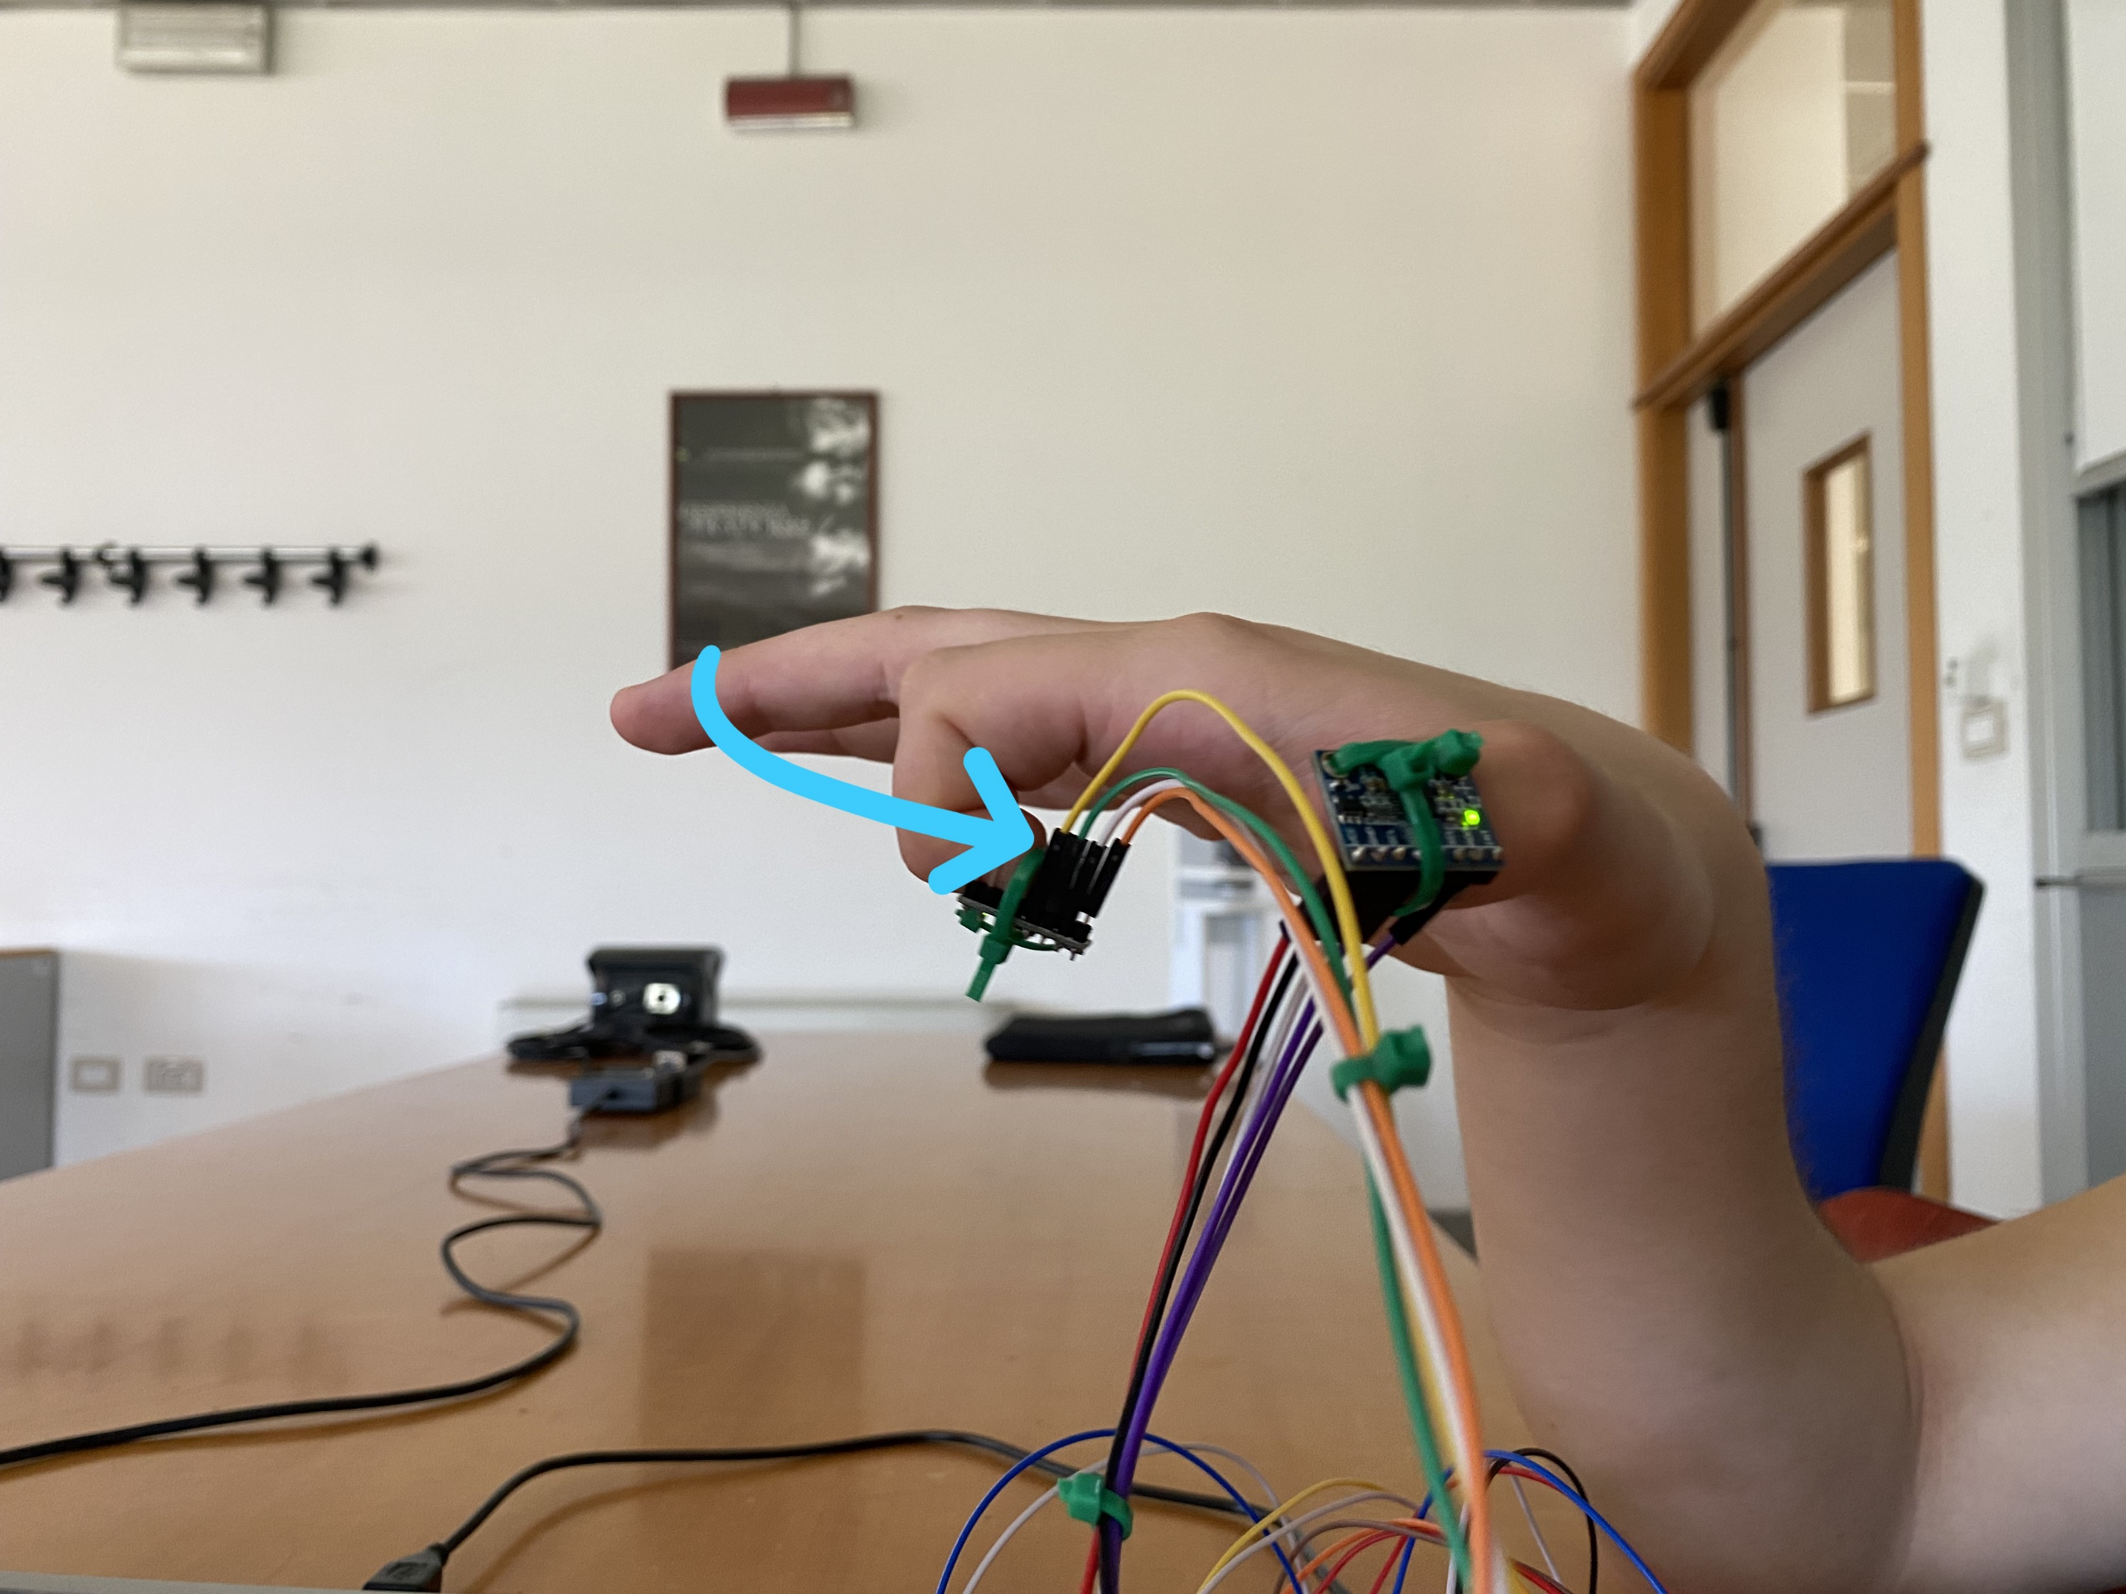
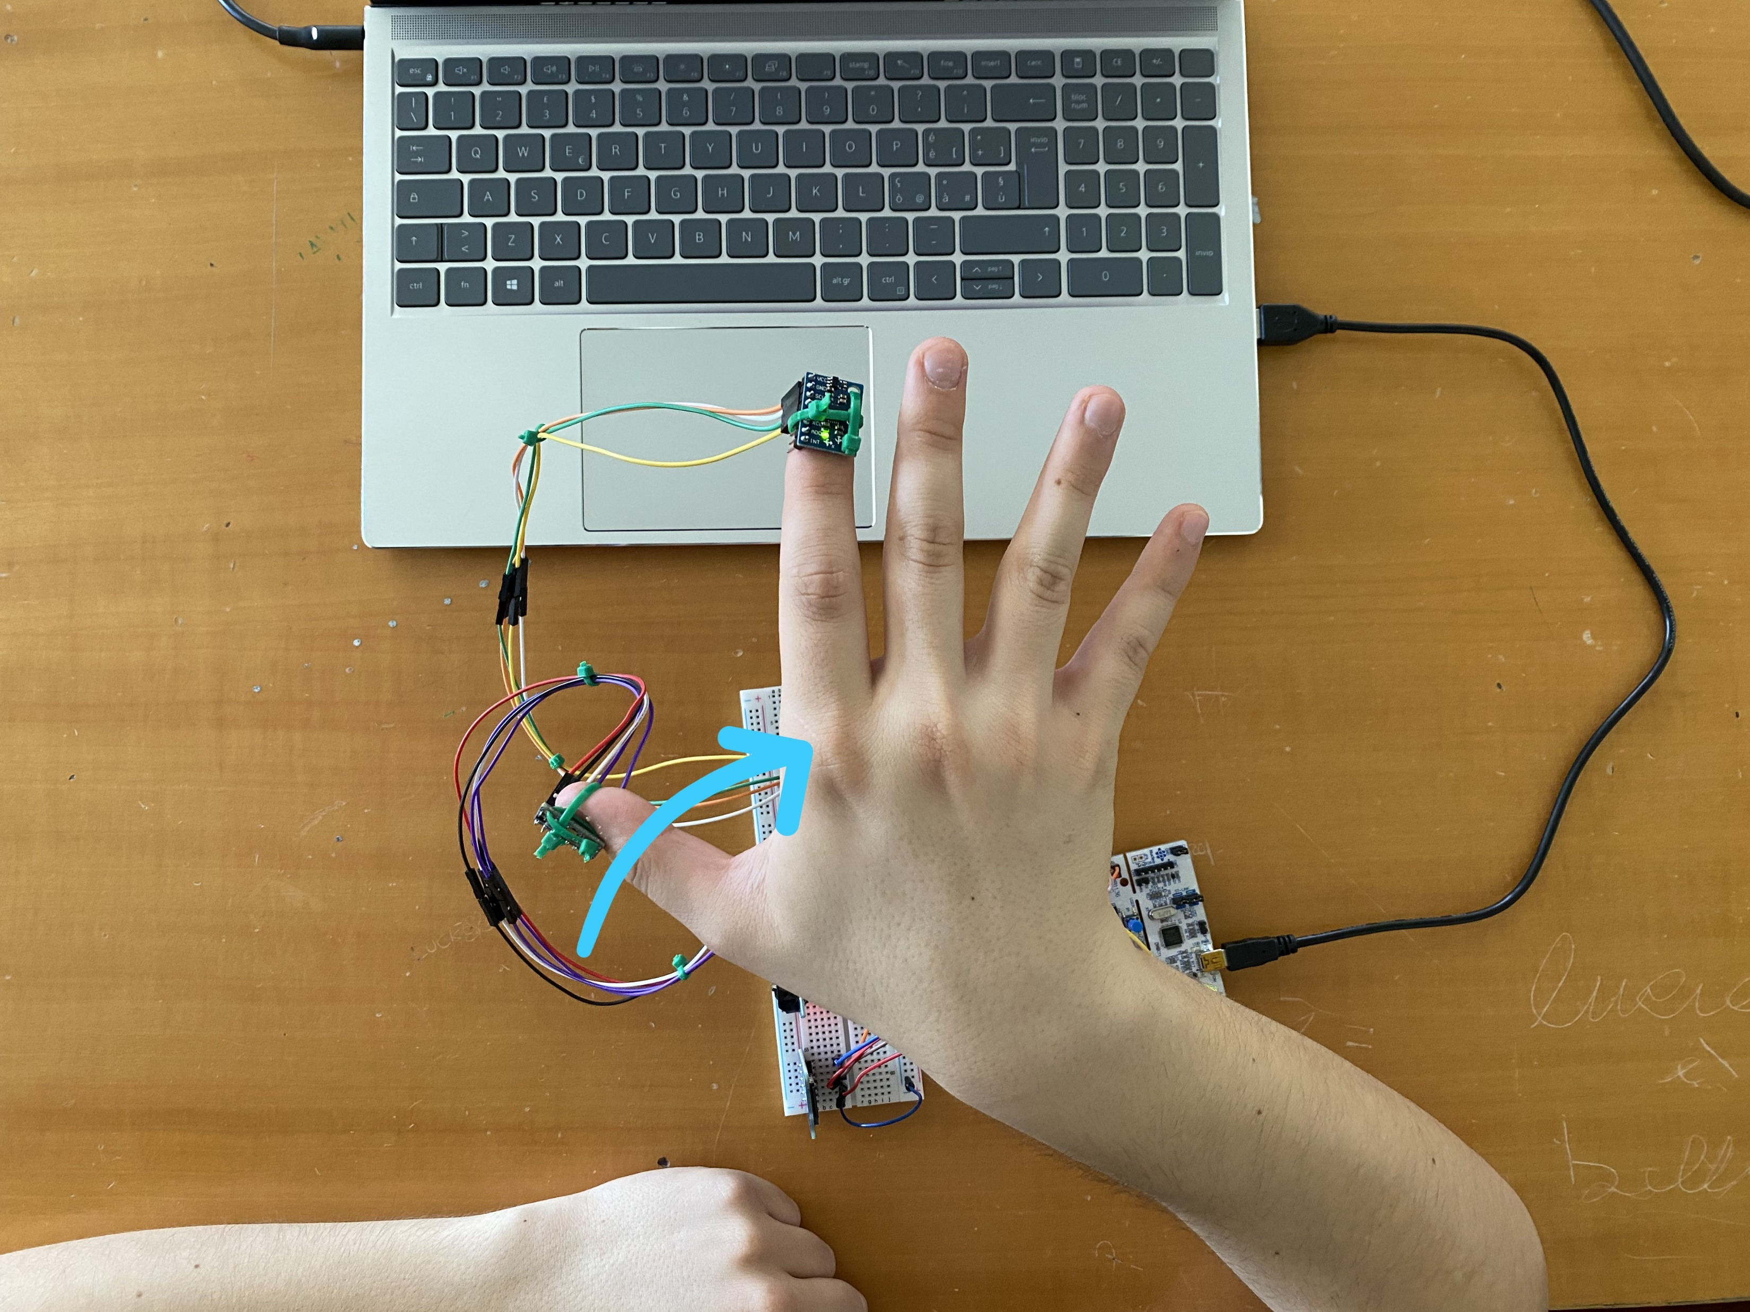
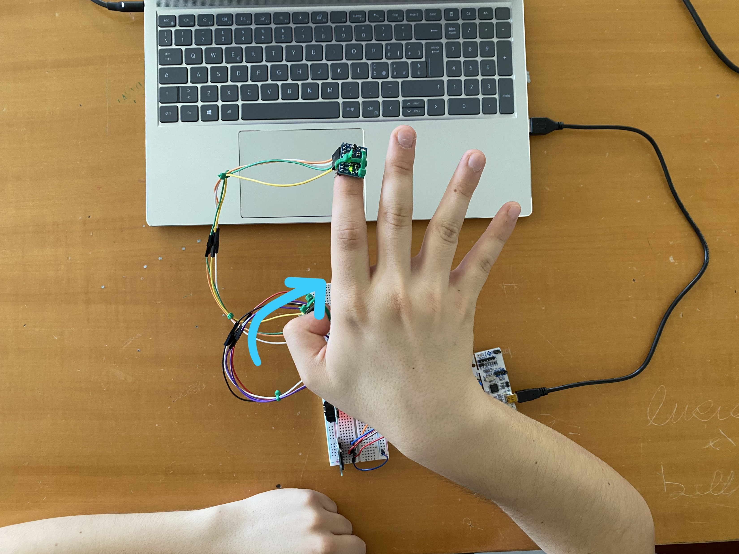
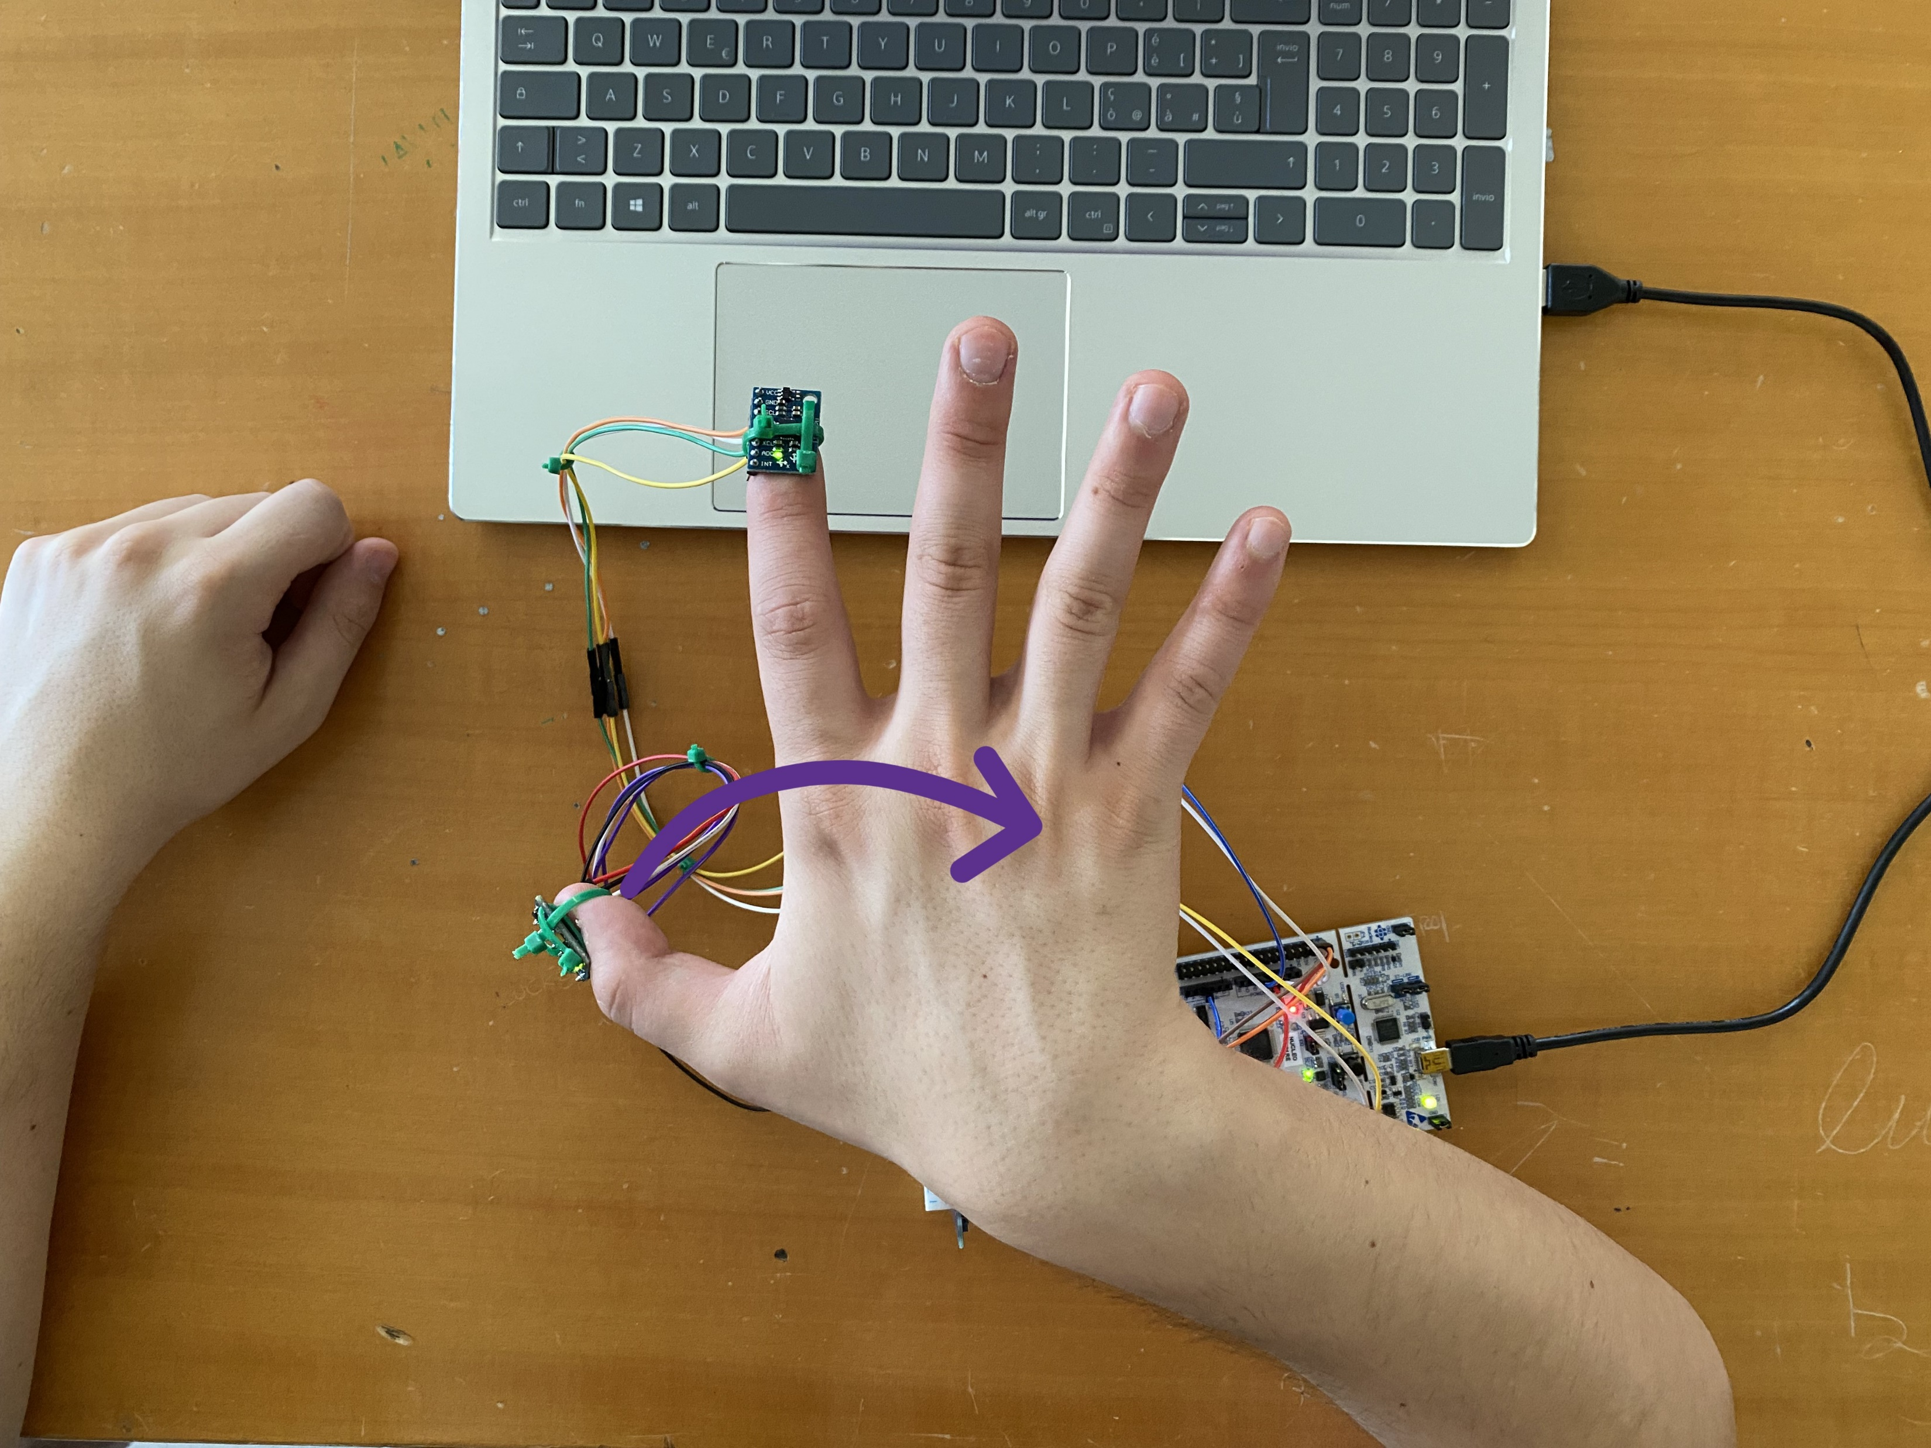
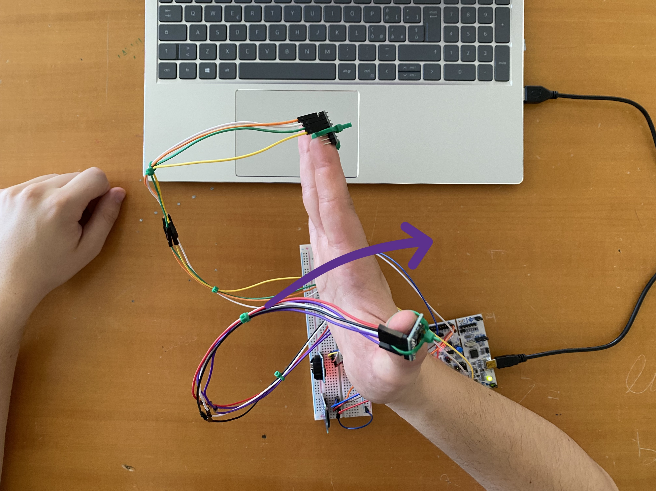
Some Gestures
Right Movement
Left Click (and double click)
Zoom In (and Zoom Out)
Enter in ALT+TAB mode

Slide 9
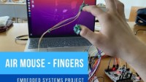
How it works

Slide 10
Thanks for the attention!

